Slide 2
Modelo 2
Train batch size=32
Test bach size =32
InceptioV3: last layer mixed7
Pretrained weights no trainable
rescale=1.0/255., rotation_range=45, width_shift_range=0.1, height_shift_range=0.3, zoom_range=0.2, channel_shift_range=10.0, horizontal_flip=True, fill_mode='constant
optimizer = RMSProp(learning_rate=0.0001)
Train accuracy ~0.99-1
Val accuracy ~0.6-0.7

Slide 3
Modelo 3
Train batch size=46
Test bach size =19
InceptioV3: last layer mixed10
Pretrained weights all trainable
rescale=1.0/255., rotation_range=45, width_shift_range=0.1, height_shift_range=0.3,
shear_range=0.1, zoom_range=0.2, channel_shift_range=10.0, horizontal_flip=True, fill_mode='constant
optimizer = Adam(learning_rate=0.0001)
New layer=1024+dropout0.5
T_epoch~440s
Train accuracy ~0.99-1
Val accuracy ~0.7-0.76

Slide 4
Modelo 4
Train batch size=32
Test bach size =32
InceptioV3: last layer mixed1
Pretrained weights trainable
rescale=1.0/255., rotation_range=45, width_shift_range=0.1, height_shift_range=0.3, shear_range=0.1, zoom_range=0.2, channel_shift_range=10.0, horizontal_flip=True, fill_mode='constant
Callback = 99.9%(train)
Train accuracy ~
Val accuracy ~

Slide 5
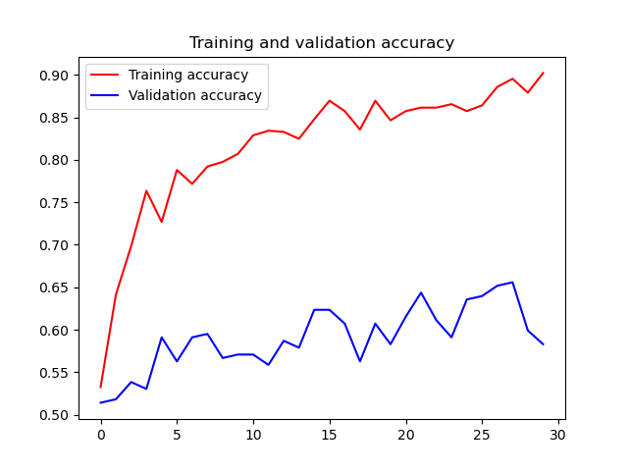
Modelo 5
Train batch size=32
Test bach size =32
InceptioV3: last layer mixed10
Pretrained weights non-trainable
rescale=1.0/255., rotation_range=45, width_shift_range=0.1, height_shift_range=0.3, shear_range=0.1, zoom_range=0.2, channel_shift_range=10.0, horizontal_flip=True, fill_mode='constant
optimizer = Adam(learning_rate=0.0001)
New layer=1024+dropout0.5
Train accuracy ~
Val accuracy ~

Slide 6
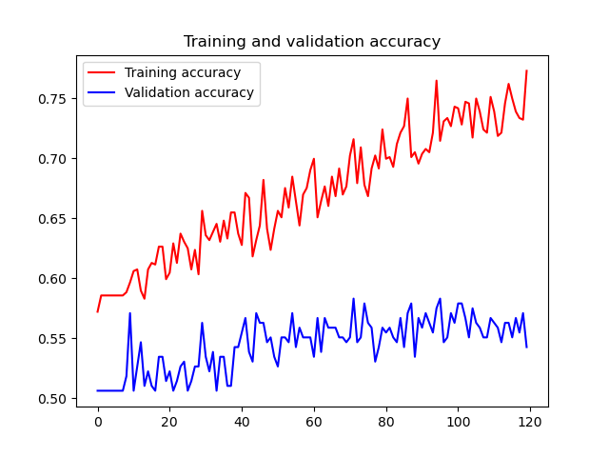
Modelo6
Mismos parámetros augmentation que modelo 5
model = tf.keras.models.Sequential(
[tf.keras.layers.Conv2D(32, (3,3), activation='relu', input_shape=(300, 300, 1)),
tf.keras.layers.MaxPooling2D(2, 2),
tf.keras.layers.Conv2D(64, (3,3), activation='relu'),
tf.keras.layers.MaxPooling2D(2,2),
tf.keras.layers.Conv2D(128, (3,3), activation='relu'),
tf.keras.layers.MaxPooling2D(2,2),
tf.keras.layers.Conv2D(128, (3,3), activation='relu'),
tf.keras.layers.MaxPooling2D(2,2),
tf.keras.layers.Flatten(),
tf.keras.layers.Dropout(0.5),
tf.keras.layers.Dense(512, activation='relu'),
tf.keras.layers.Dense(1, activation='sigmoid')
])
model.compile(optimizer = Adam(learning_rate=0.0001),
loss = 'binary_crossentropy',
metrics = ['accuracy'])

Slide 7
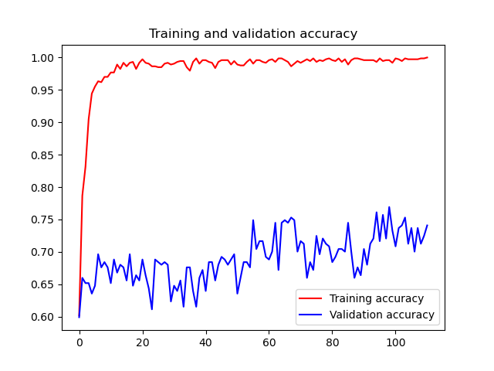
Modelo 7
Train, test batch size=32
InceptioV3: last layer mixed10
Pretrained weights non-trainable up to ‘mixed7’; trainable from there
rescale=1.0/255., rotation_range=45, width_shift_range=0.1, height_shift_range=0.3, shear_range=0.1, zoom_range=0.2, channel_shift_range=10.0, horizontal_flip=True, fill_mode='constant
optimizer = Adam(learning_rate=0.0001)
New layer=1024+dropout0.5
Train accuracy ~
Val accuracy ~

Slide 8
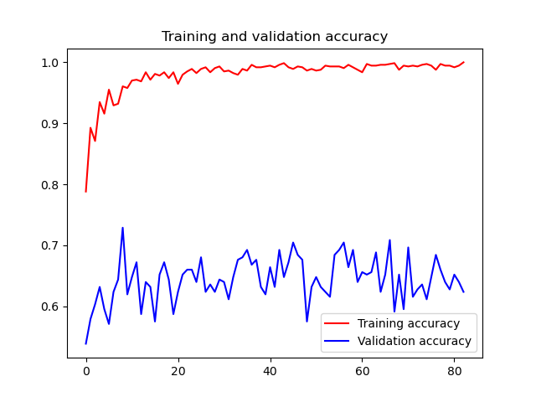
Modelo 8
Train, test batch size=32
InceptioV3: last layer mixed10
Pretrained weights non-trainable up to ‘mixed9’; trainable from there
rescale=1.0/255., rotation_range=45, width_shift_range=0.1, height_shift_range=0.3, shear_range=0.1, zoom_range=0.2, channel_shift_range=10.0, horizontal_flip=True, fill_mode='constant
optimizer = Adam(learning_rate=0.0001)
New layer=1024+dropout0.5
Train accuracy ~
Val accuracy ~

